Slide 1







Angular Fundamentals
Course Overview, Trainers, Evaluation
Angular Development
SoftUni Team
Technical Trainers
Software University
http://softuni.bg

Slide 2

Table of Contents
Course Objectives
Course Program
Trainers Team
Course Schedule
Exams and Evaluation
Learning Resources

Slide 3
Have a Question?
sli.do #angular-js

Slide 4

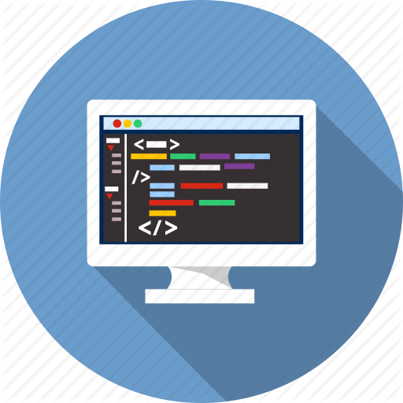

Angular Fundamentals
Angular Fundamentals
Course Objectives & Program

Slide 5



Course Objectives
Learn:
Single Page Applications
Angular.js framework fundamentals
Client-side applications with Angular.js
Working with remote data
Component-based applications
End-to-end JavaScript applications

Slide 6
Warning: Not for Absolute Beginners
The "Angular" course is NOT for absolute beginners
Take the HTML & JavaScript courses at SoftUni first: https://softuni.bg/trainings/1271/web-fundamentals-html-css-november-2015 https://softuni.bg/trainings/1295/javascript-basics-january-2016
This course is OK for beginners, but requires previous coding skills
Requirements
HTML & JS (ES 2016) coding skills – entry level
Computer English – entry level

Slide 7
Course Topics
Course Introduction
Installation & Hello World
Components & Markup
Services & Dependency Injection
Modules & Routing
Directives & Forms
Architecture & Best Practices

Slide 8
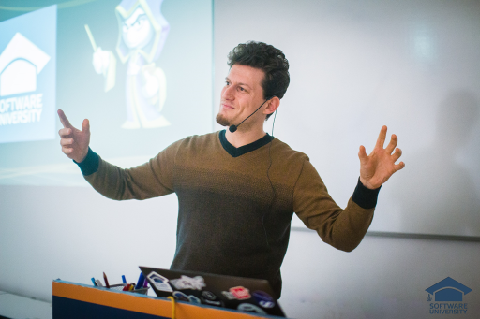
The Trainers Team

Slide 9

The Trainer
Ivaylo Kenov
Various job titles at the same time:
Mathematical competitions champion
Full Stack Technical Trainer
Senior Software Developer
Solutions Architect & Technical Lead
One-man army @ https://MyTestedASP.NET
{Insert Jot Title Here}
Contacts
https://github.com/ivaylokenov
https://facebook.com/ivaylo.kenov
https://linkedin.com/in/kenov

Slide 10
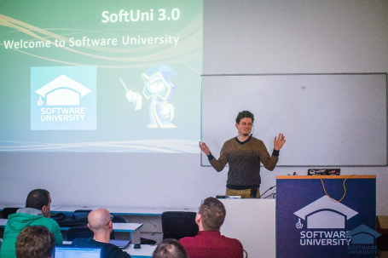


Angular Fundamentals
Course Details and Schedule

Slide 11
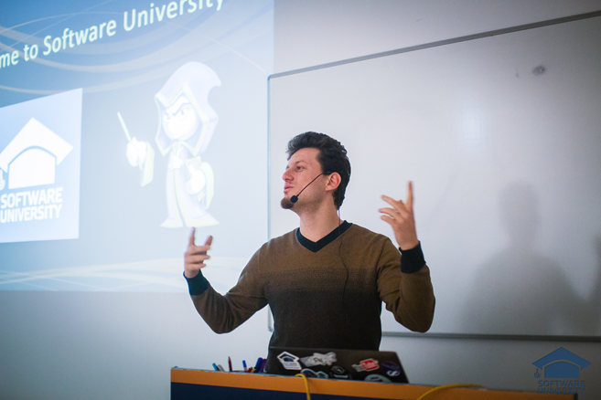
Training Duration and Schedule
Lessons: ~ 56 hours (onsite + YouTube videos)
Practical exercises (in class): ~ 60 hours
Practical exam: 6 hours
Allocation
Timeframe: July – August 2017
Teamwork Defense : 15 August 2017

Slide 12


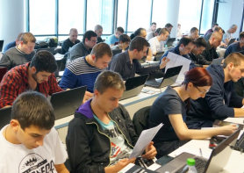
Angular Fundamentals
Evaluation Criteria

Slide 13


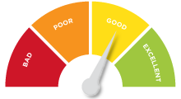
Scoring System for the Course
Practical exam – 70%
Teamwork defense – 20%
Exercise submissions – 10%
Forum activity – bonus up to 5%
Presence in class – 5% bonus

Slide 14


Homework Assignments
Your homework is mainly work in class!
Lesson days → live workshop
Exercise days → only exercises
How to submit your homework?
Some submitted in the judge system
Others uploaded in the course Web site
Homework assignments are due in 1 week

Slide 15










Resources
What We Need Additionally?

Slide 16

Course Web Site & Forums
The Angular Course official web site:
Register for the "Software University Forum":
Discuss the course exercises with your colleagues
Find solutions for all course exercises
Share source code / discuss ideas / help each other
https://softuni.bg/trainings/1644/angular-2-fundamentals-july-2017
https://softuni.bg/forum/categories/110/angular

Slide 17

The Software Technologies Slides and Videos
All lecture slides, videos, homework assignments, projects and other resources are open content, available for free
Visit the course web site to access the course resources

Slide 18
Recommended Software
Software needed for this course:
Node.js (Current Version) - https://nodejs.org/en/download/
MongoDB (Optional) - https://www.mongodb.com/download-center
WebStorm – https://jetbrains.com/webstorm/
or
Visual Studio Code – https://www.visualstudio.com

Slide 19










Angular – Course Intro
https://softuni.bg/courses/angular-2-fundamentals

Slide 20
License
This course (slides, examples, demos, videos, homework, etc.) is licensed under the "Creative Commons Attribution-NonCommercial-ShareAlike 4.0 International" license

Slide 21





Trainings @ Software University
Software University Foundation – softuni.org
Software University – High-Quality Education, Profession and Job for Software Developers
softuni.bg
Software University @ Facebook
facebook.com/SoftwareUniversity
Software University Forums – forum.softuni.bg

